Slide 1
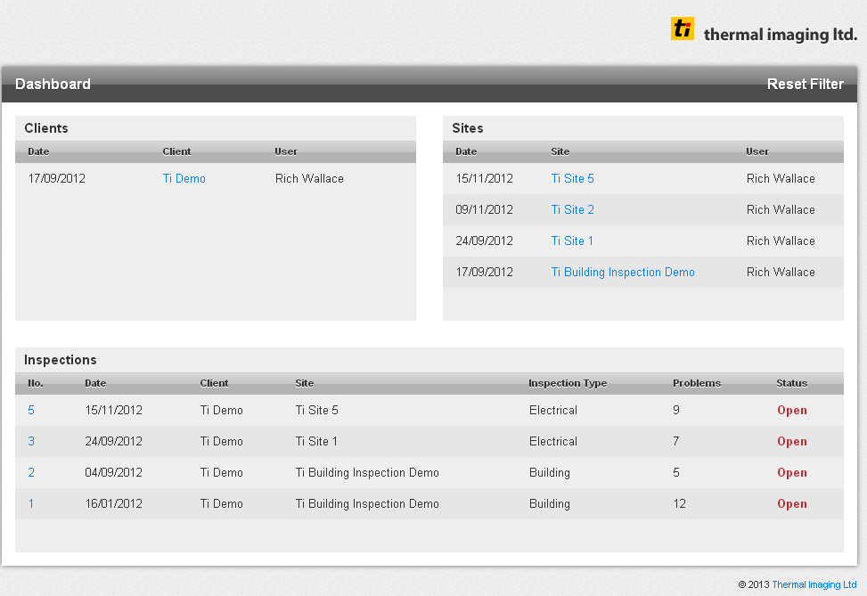
WEBCOR™ Campaign Management Software Preview
Your Dashboard

Slide 2
Your Inspection Manager

Slide 3
Your Problem Manager

Slide 4
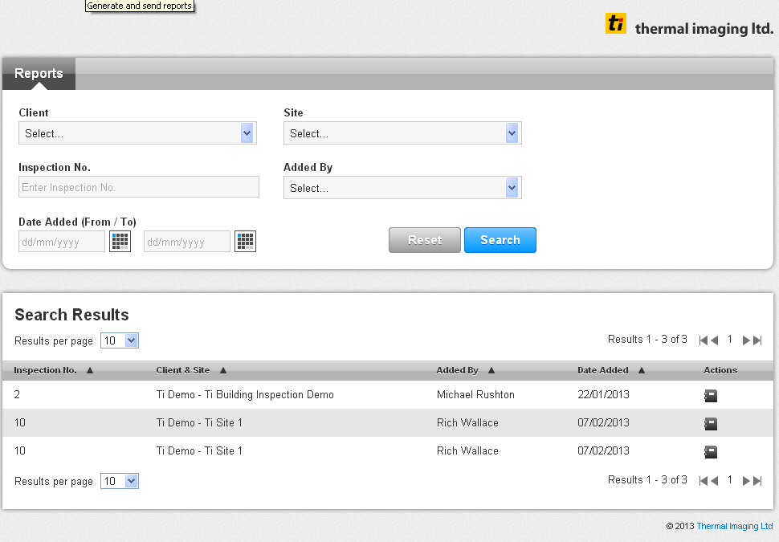
Your Report Manager

Slide 5
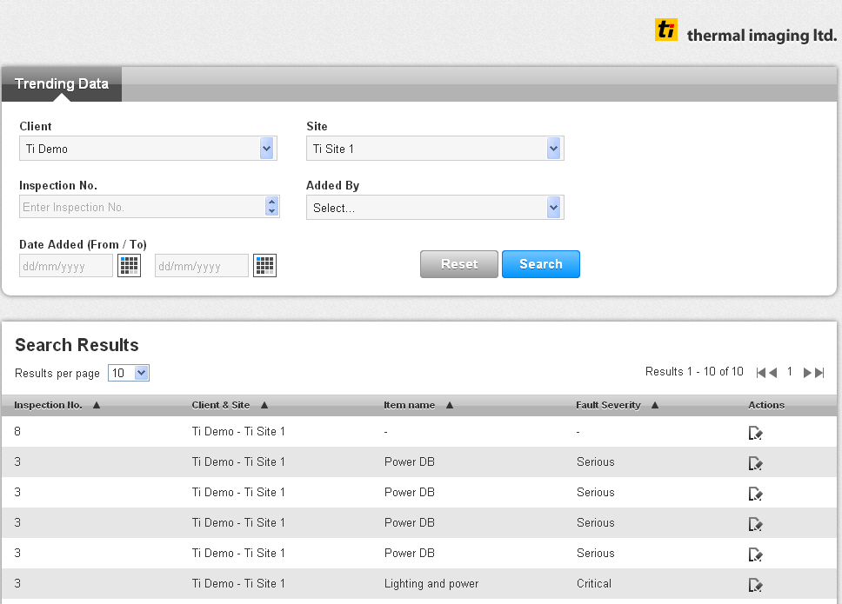
Your Equipment Trend Manager

Slide 6
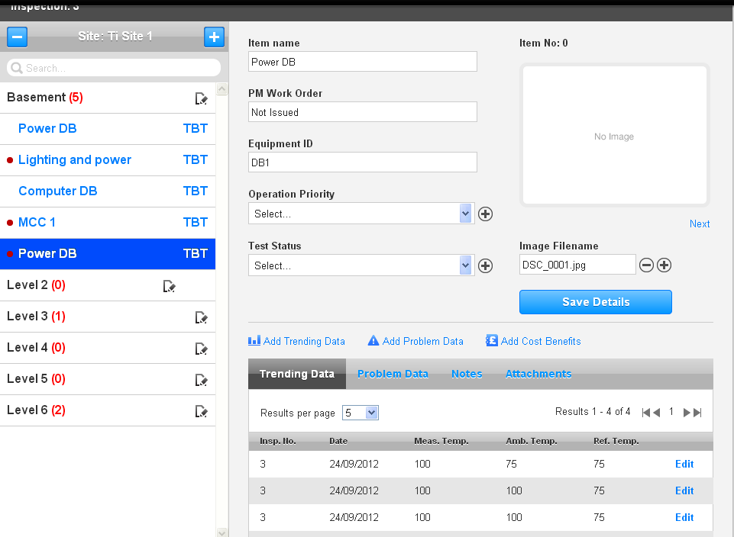
TICOR™ Tablet Data Capture App Preview – Available Q2 2013
Input Screen

Slide 7
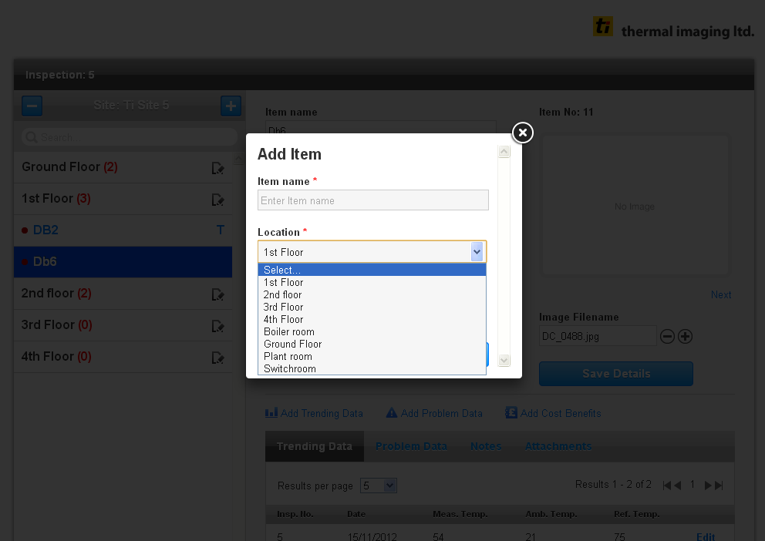
Add Item Screen

Slide 8
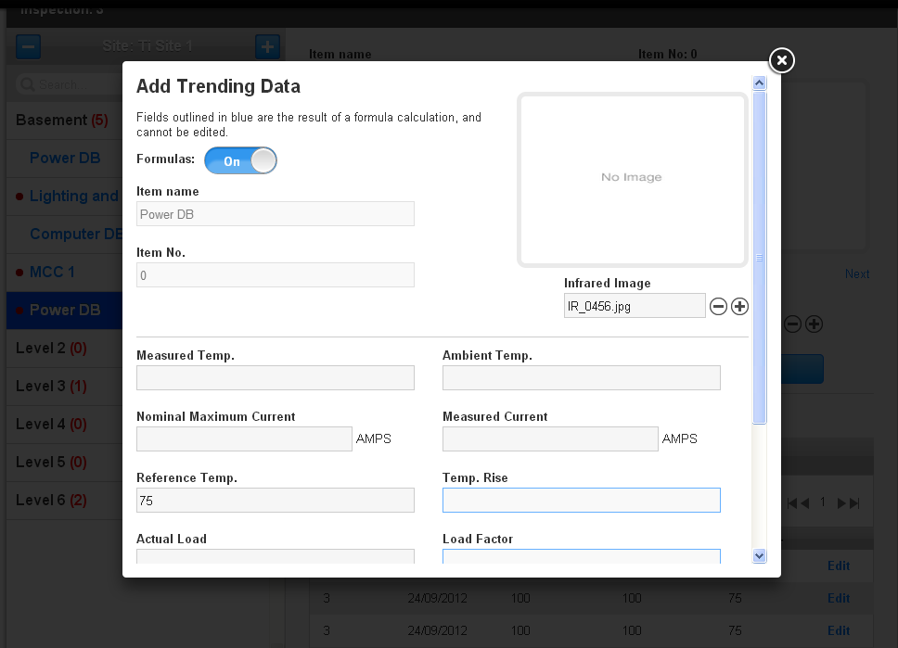
Trend data input – Prior to formulas

Slide 9
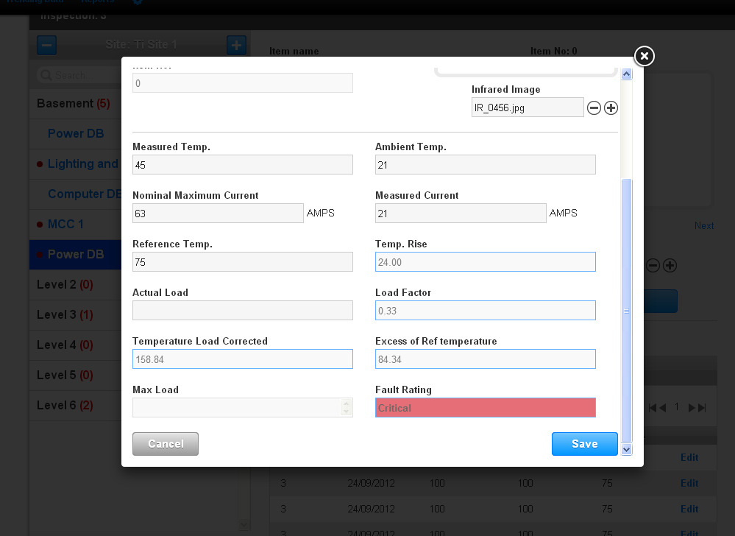
Trend data input – Post formula, auto fault detection

Slide 10
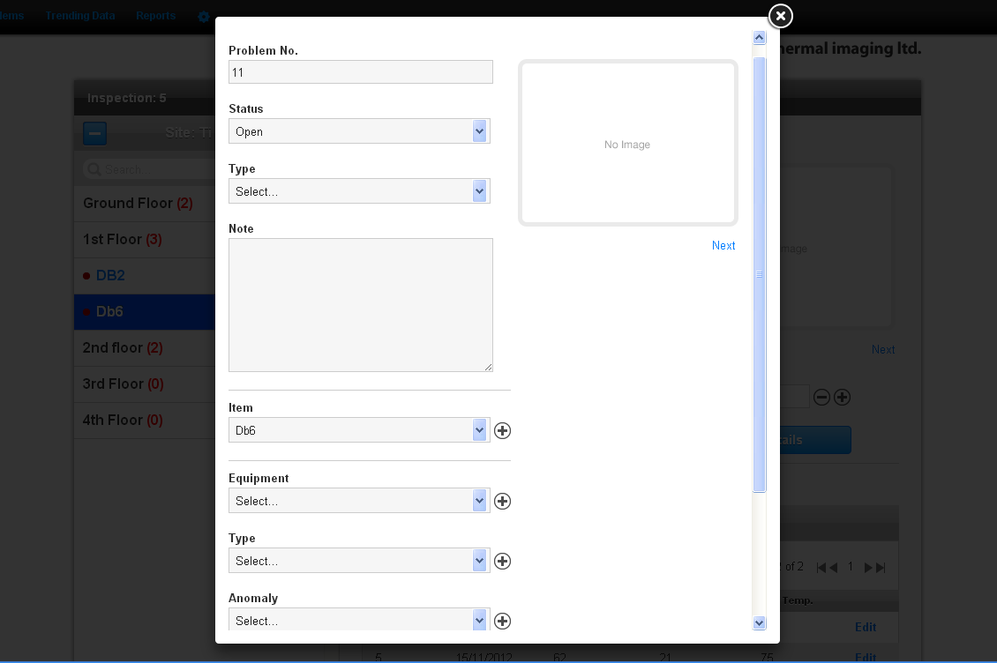
Add Problem Screen

